Slide 1
The Extremely Large Telescope: standing on the shoulder of Open Source and AlmaLinux
How open source will help the biggest telescope see the cosmos
Federico (fpellegr@eso.org), Piotr (pszubiak@eso.org)

Slide 2
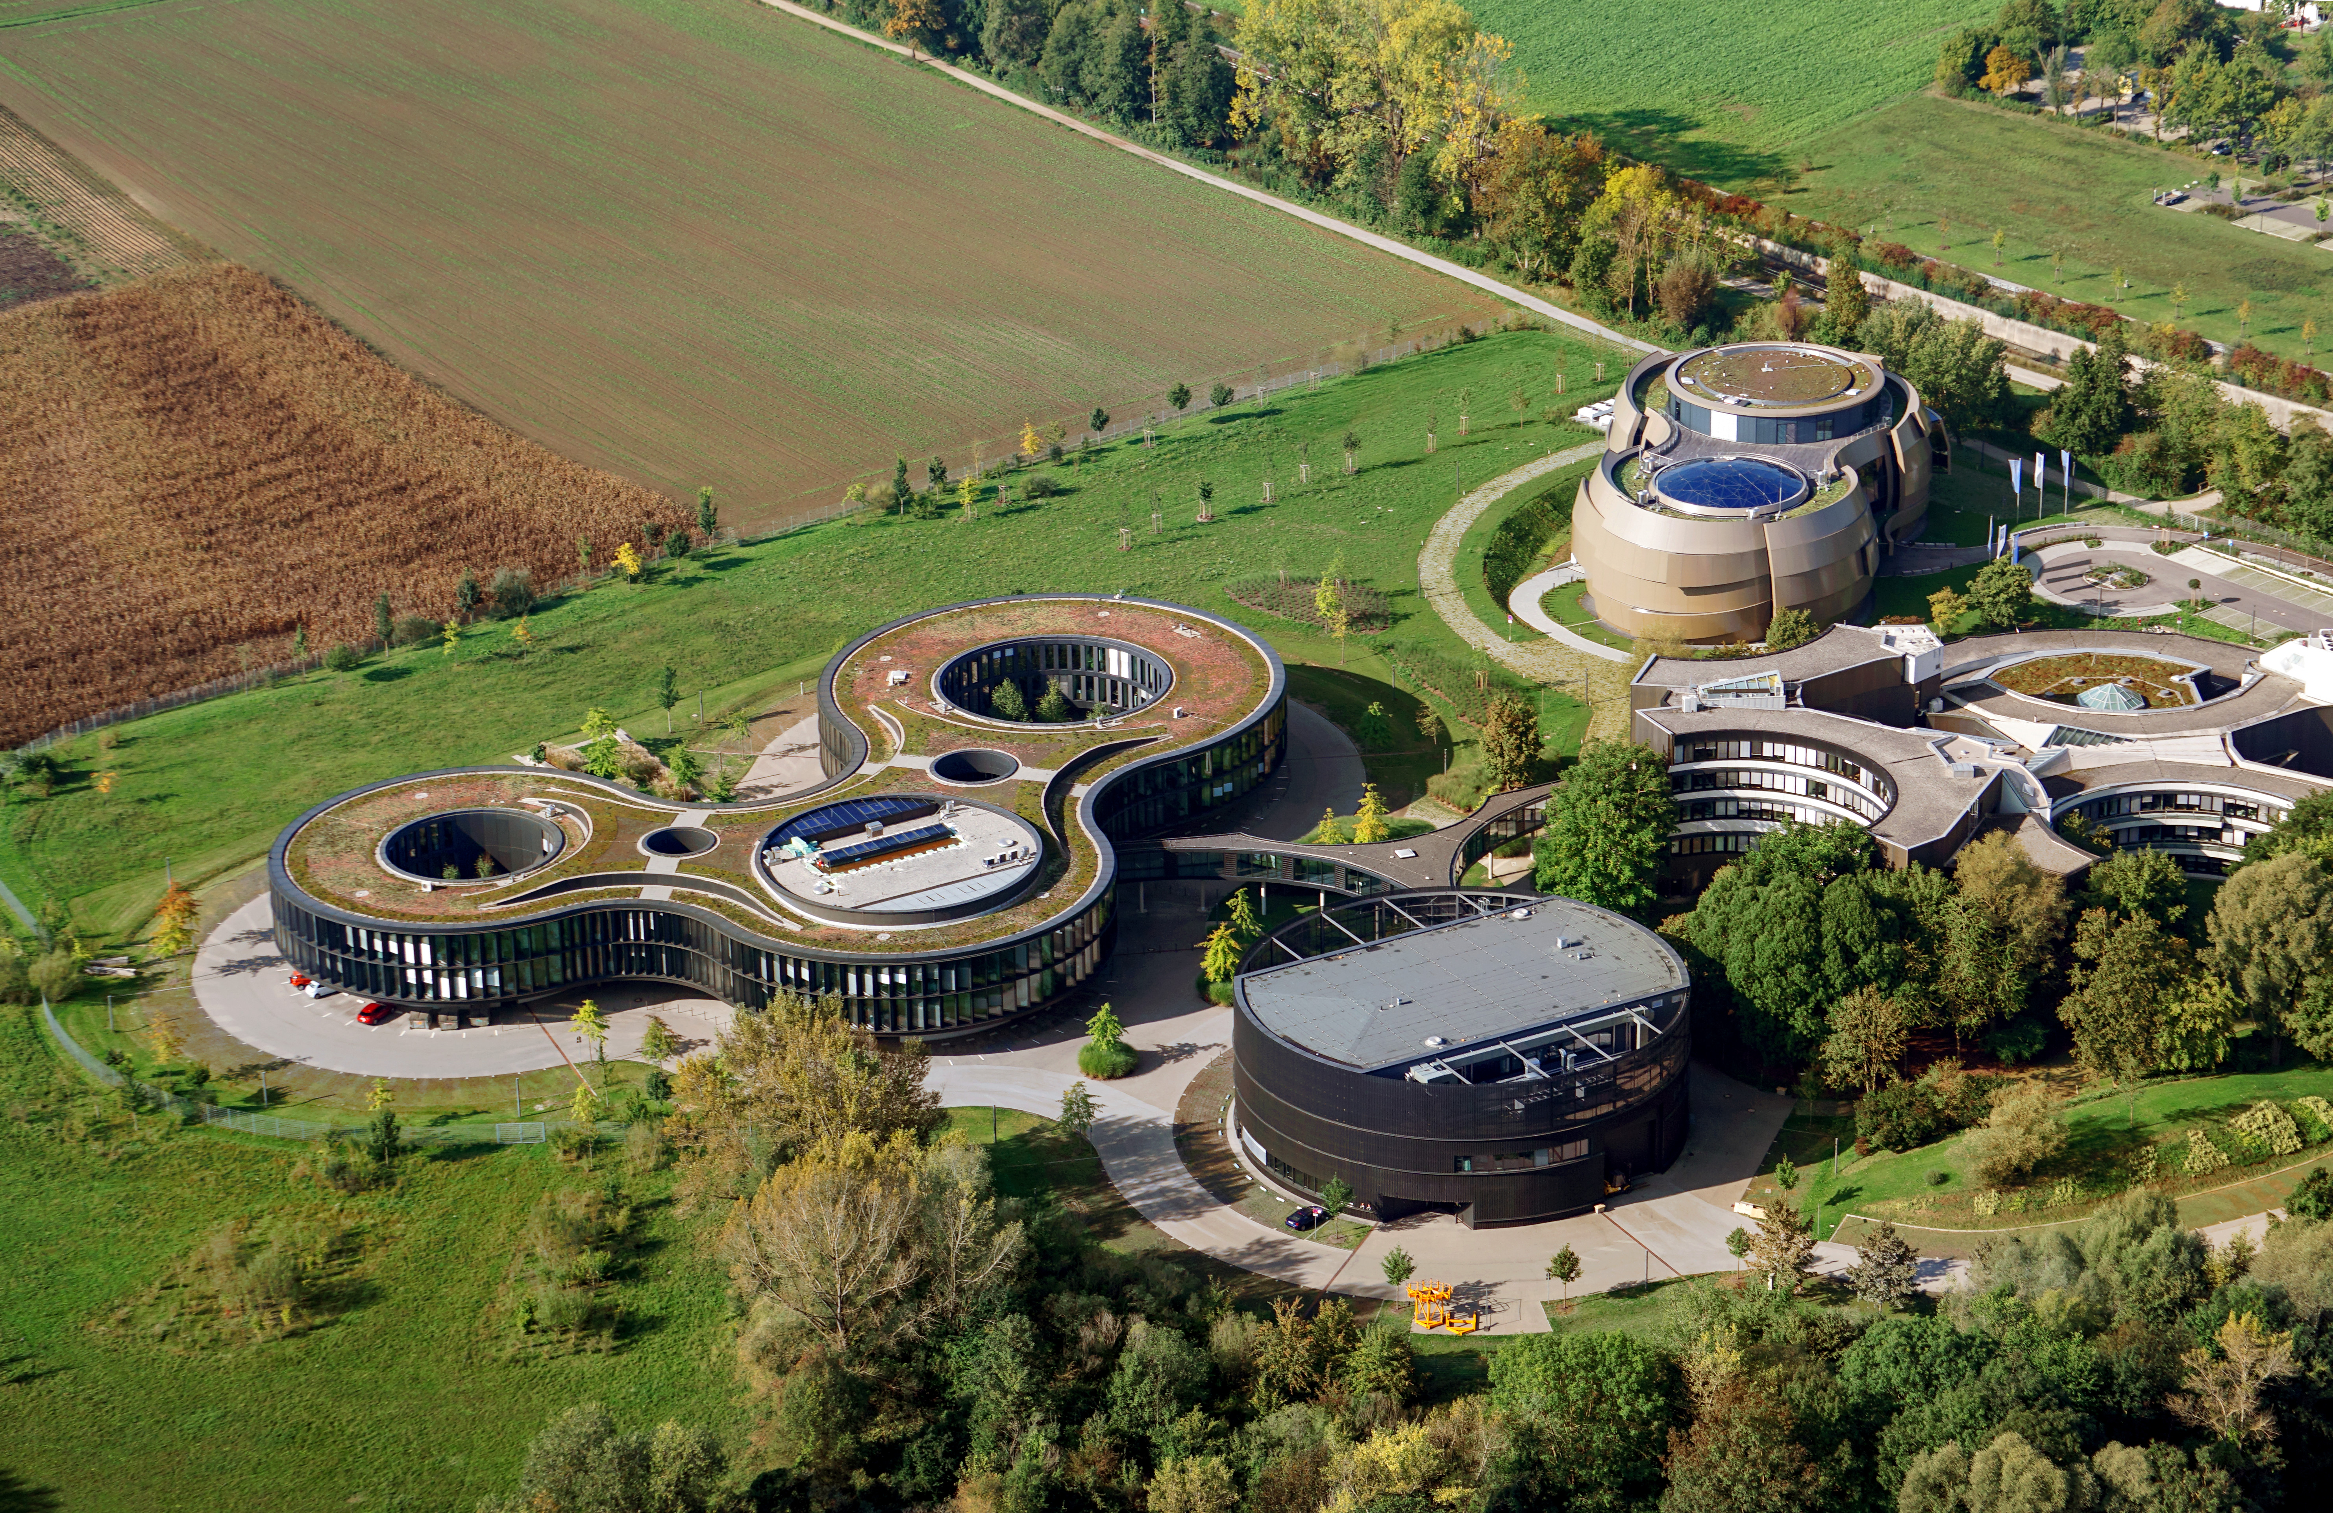
About European Southern Observatory - ESO
  Intergovernmental organization providing facilities for ground based modern astronomy
  Founded in 1962
  16 member states (+ Chile and Australia)
  Headquarters in Garching near Munich
  All astronomical facilities in Chile

Slide 3
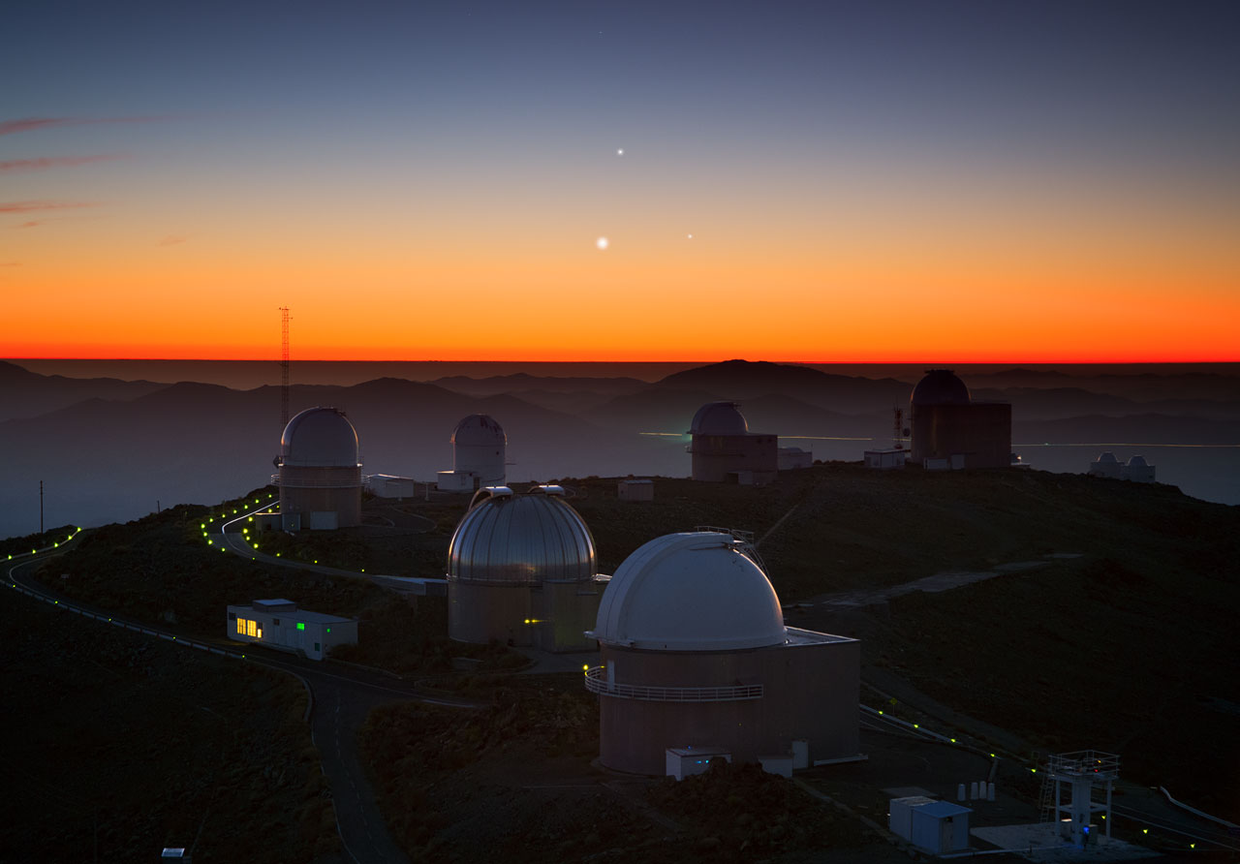
ESO Observatories – La Silla
  Operational since 1966 (and 1976 first light of 3.6m)
    ~10 telescopes still in operation today
    Some telescopes have software frozen for decades
  Still producing very important science
    Nobel prize in 2019 with HARPS (+ESPRESSO)
    Still some new instruments being deployed
  And we get visits from local fauna:
    Guanacos, vicunas, foxes, rabbits....

Slide 4
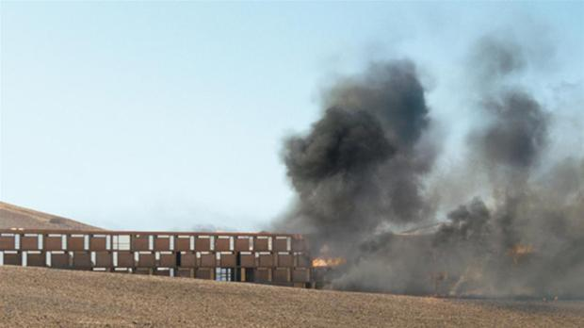
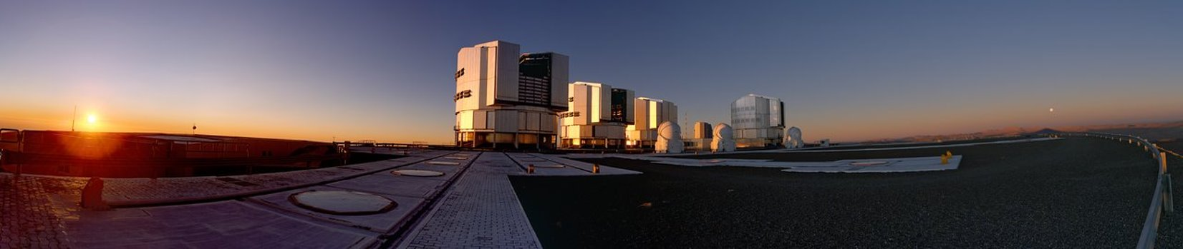
ESO Observatories – Paranal
  Operational since 1999 (first light of UT1)
  Very Large Telescope (4 x 8m visible)
    Control Software runs on AlmaLinux 9
  VLT Interferometer (4 x 8m VLT + 4 x 1.8m AT)
    Nobel price 2020 – black hole in centre of galaxy
  Other telescopes on site (VISTA, VST)
  Future home for Cherenkov Telescope Array

Slide 5
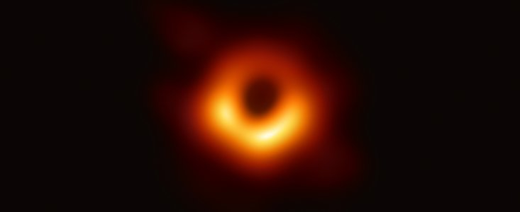
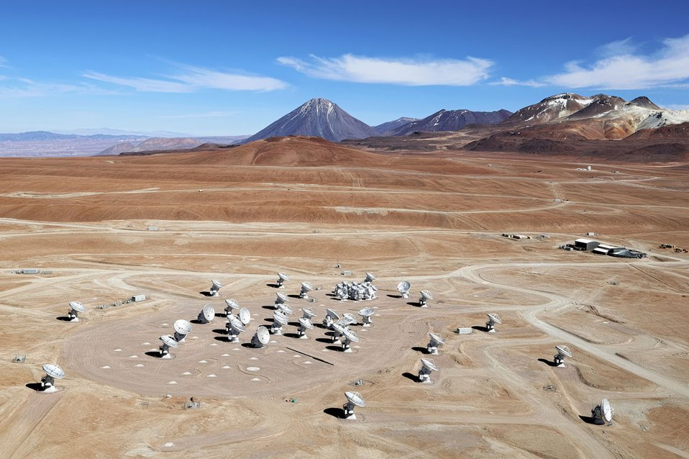
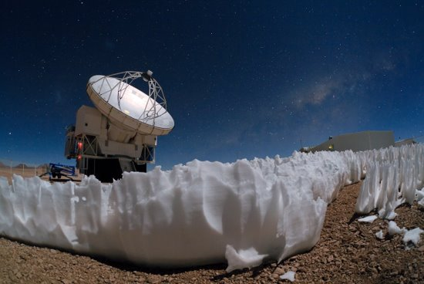
ESO Observatories – ALMA
  Joint project with NRAO and NAOJ
  Operational since 2011
  66 moveable antennas at 5000m
  Part of Event Horizon Telescope (EHT)
  APEX nearby

Slide 6
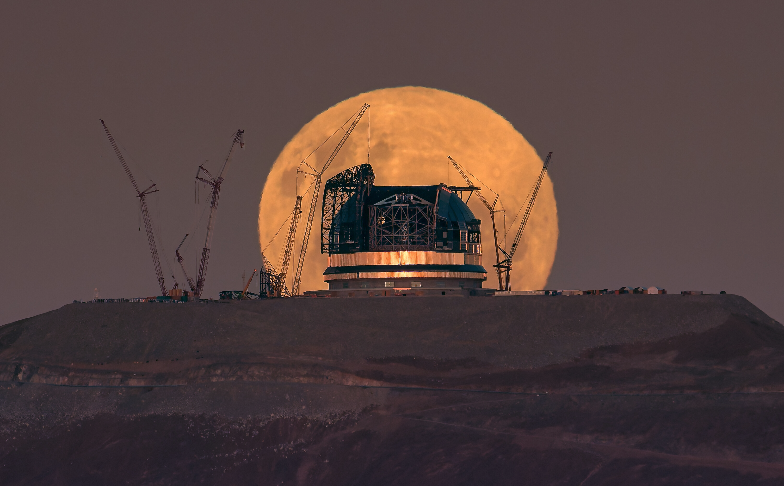
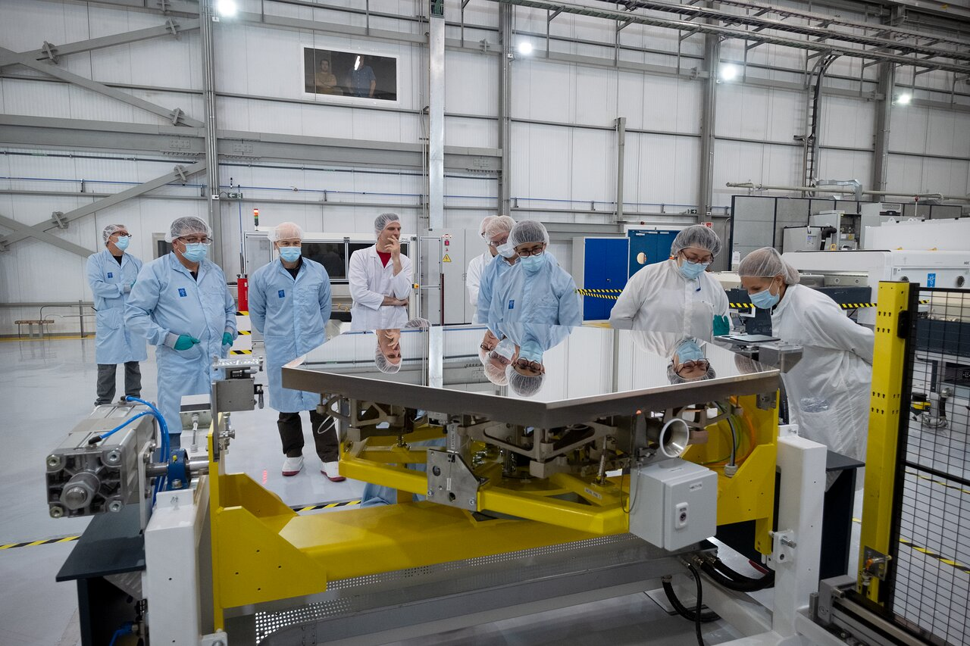
ESO Observatories – ELT
  39m mirror at Cerro Armazones (3000m)
  First stone May 2017, First light expected 2029
  Exoplanets, star formations, protoplanetary systems
  Largest optical/near-IR telescope
  M1: 798 segments 1.4 meters wide 5cm thick
  Figure loop at 500Hz ~ 1Gbit/s traffic
  M4: 4 meters (~6000 actuators)

Slide 7
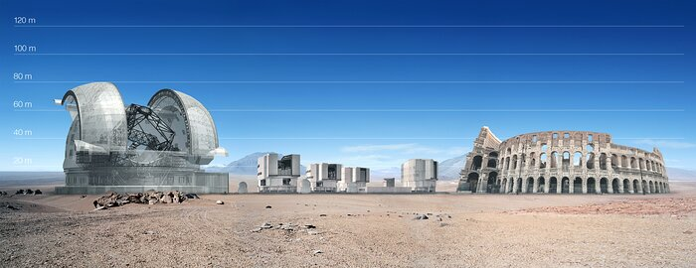
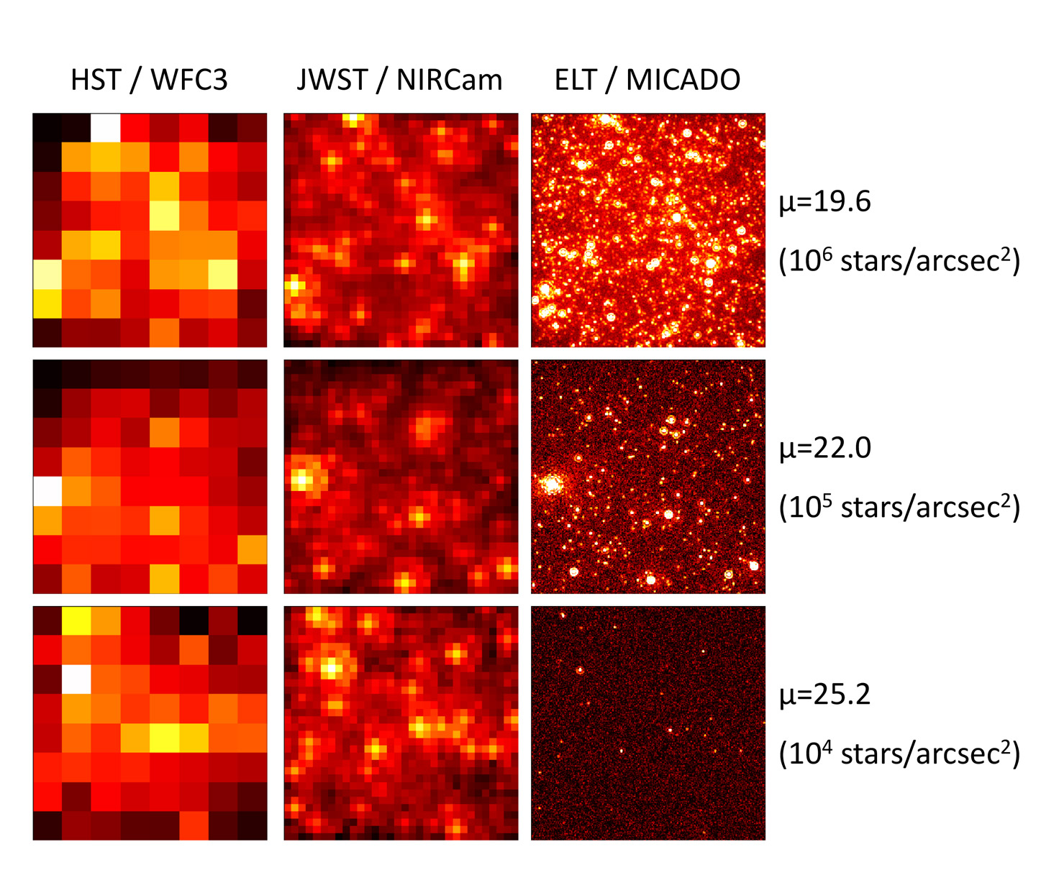
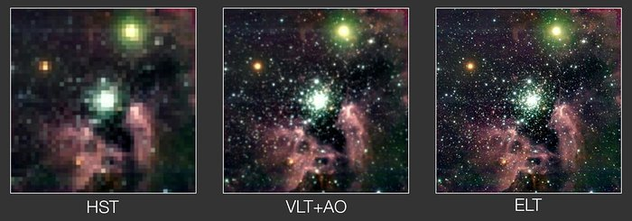
The ELT: size matters

Slide 8
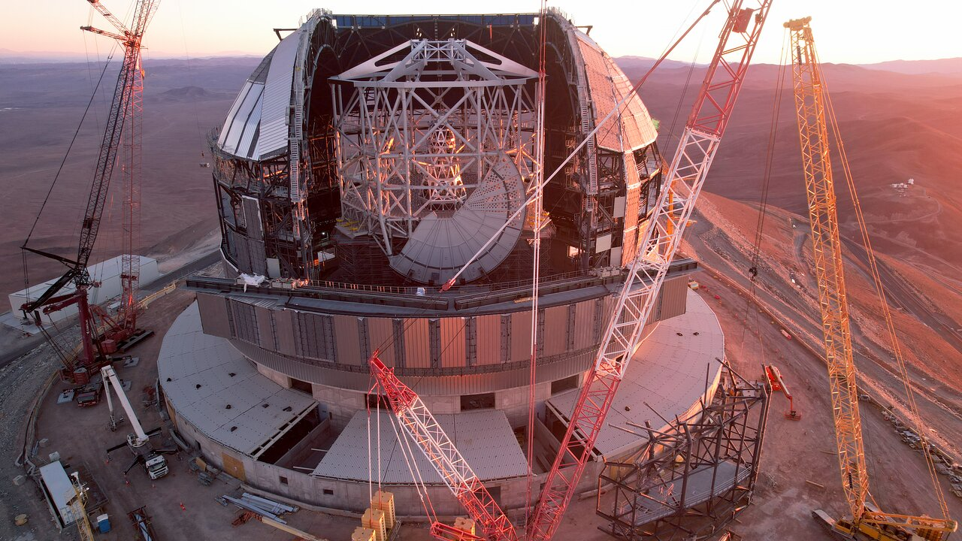
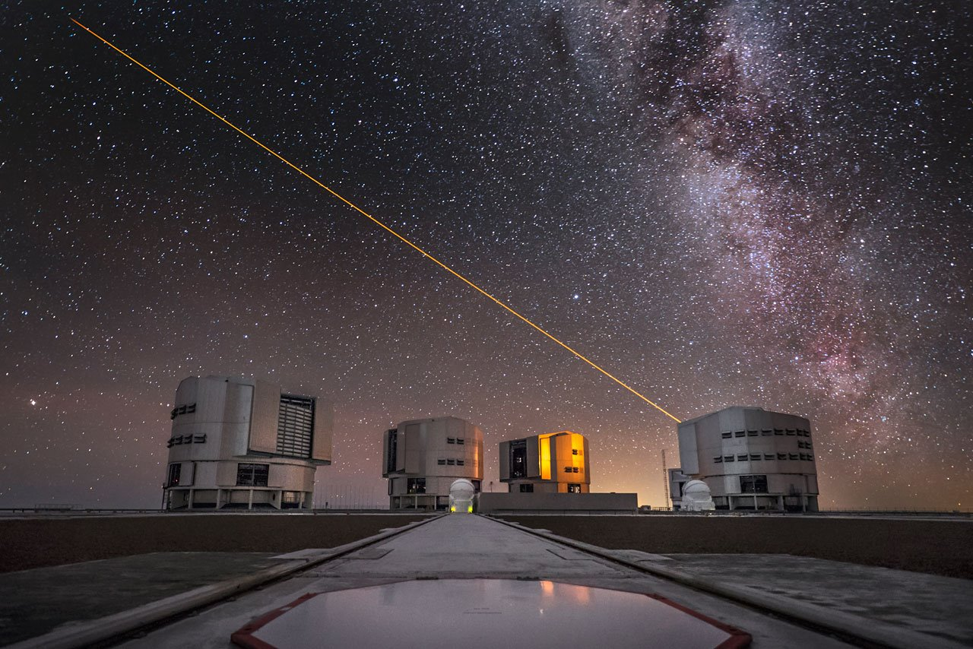
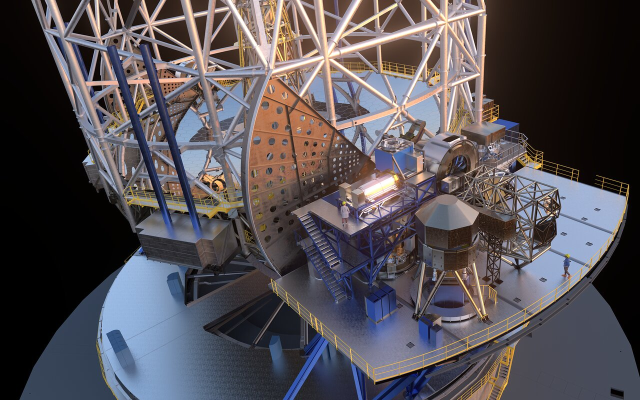
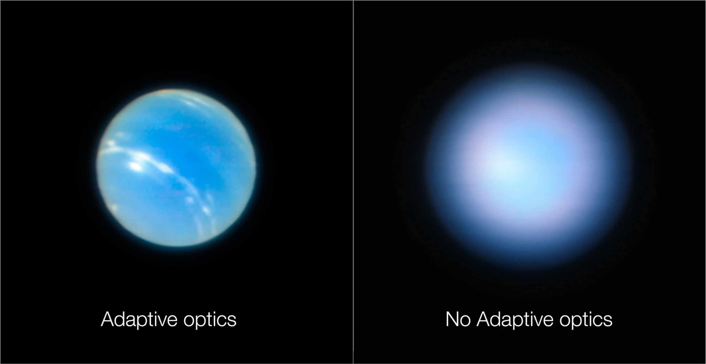
Control Software
  Real-Time system that coordinates all telescope subsystems
    Mirror alignment
    Rotation of the Dome and Main Structure
    Precise pointing and tracking
  Adaptive Optics – Laser Guide Stars and Deformable Mirrors
  Control of Instruments
    Cryogenic
    Motors
    Shutters
    Detectors

Slide 9
Why Open Source?
  Long lifespan of projects: 30+ years
    Open Source, albeit not easy, guarantees maintainability
    Cost is predictable
  Collaboration with consortia and other organizations is easier when based on Open Source
  One-off projects, no big market for big telescopes, resources available only during the construction
  Avoiding bureaucracy with acquisition and license management
  Easy access to the source makes debugging easier
  Developing on top of Open Source is fun!

Slide 10
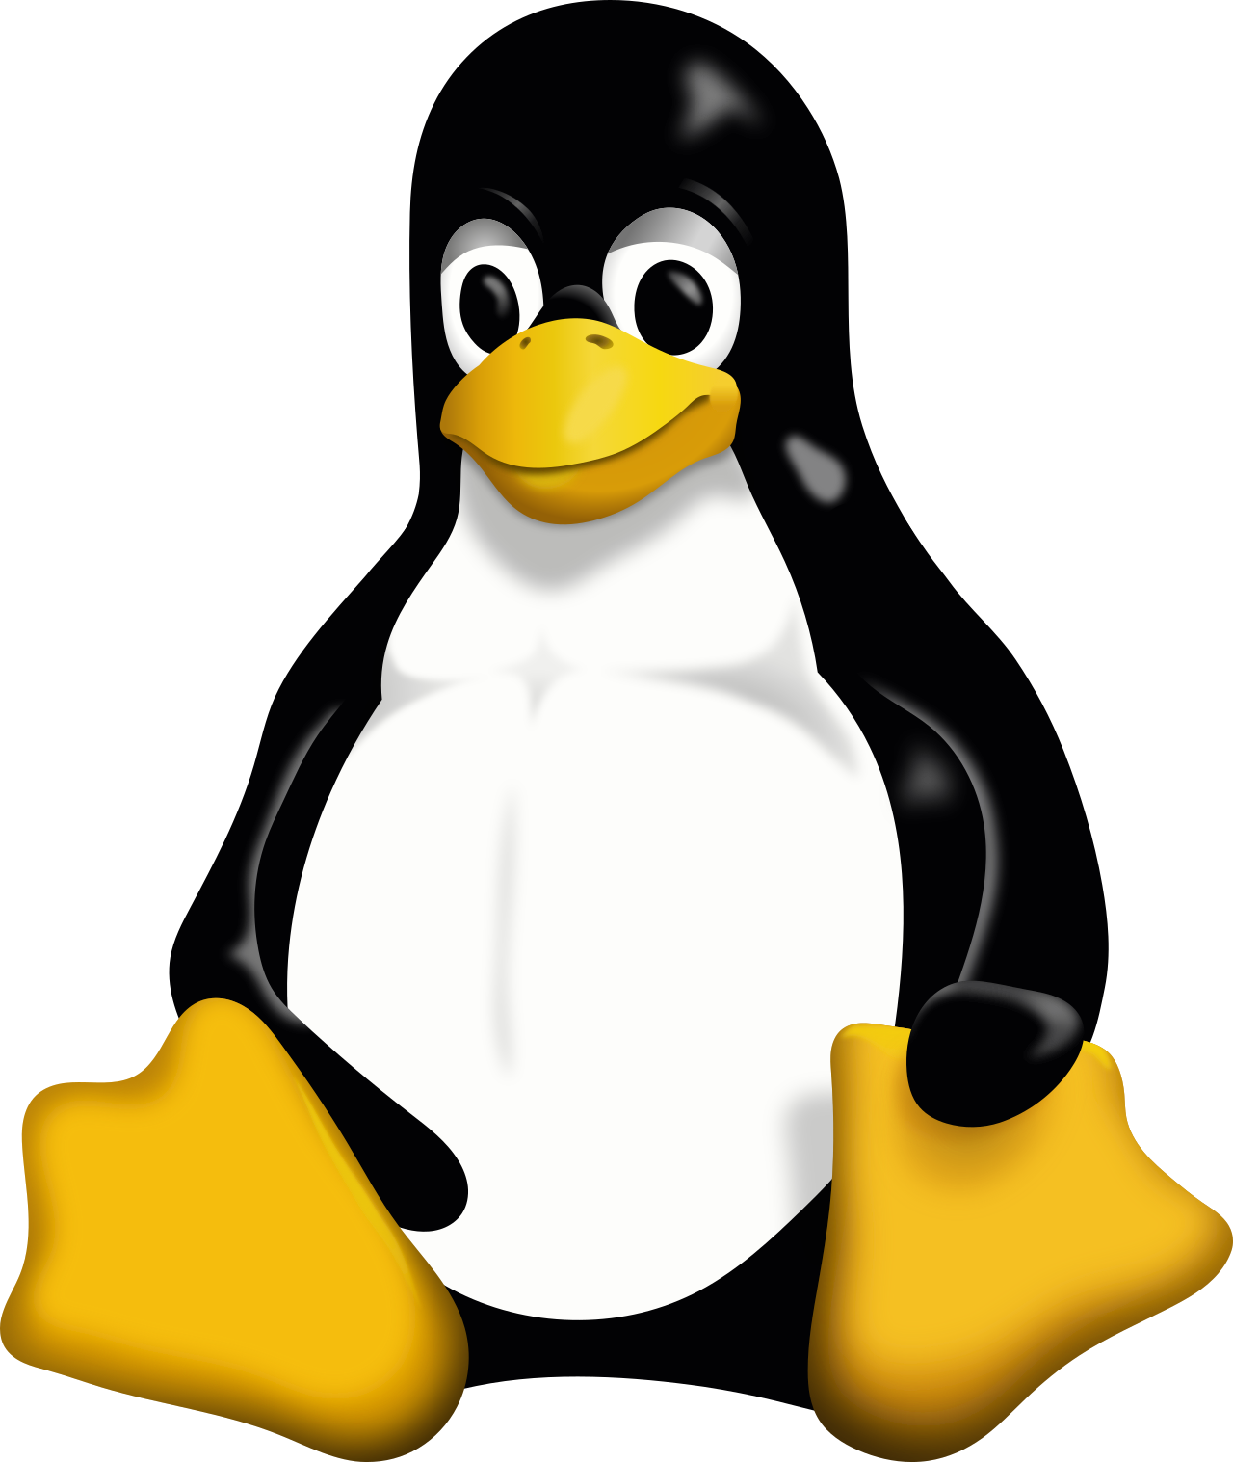
ELT Development Environment
  Linux distribution for ELT Control Software
    RPM based
    ELT DevEnv is a customized base OS (CentOS, Fedora, AlmaLinux)
    Our goal is to extend the base distribution instead of customizing
  We are close to be 100% Open Source
  Main technologies
    C/C++ and Python, waf/wtools
    Qt, KDE
    Opc UA, DDS, Protobuffer

Slide 11
Challenges in Open Source-Based Projects
  The word "support" makes management slightly… uncomfortable
  Contribution back to upstream projects may require a major effort
  Unexpected changes in project licensing
    Redis, Terraform
  Project get abandoned
    Main contributor lost interest i.e., bumpversion and bump2version
    Companies change their mind i.e., CentOS 8 (that was a hard punch for us)

Slide 12
Why AlmaLinux as Base OS for ELT?
  Predictable update policy
  Awesome AlmaLinux Team and community around!
  Super fast delivery of updates and releases
  Support for hardware removed from RHEL (including AlmaLinux 10 x86_64-v2 arch)
  ABI compatibility is more sustainable than 1:1 rebuild of RHEL
    Some fixes land faster on AlmaLinux than the upstream

Slide 13

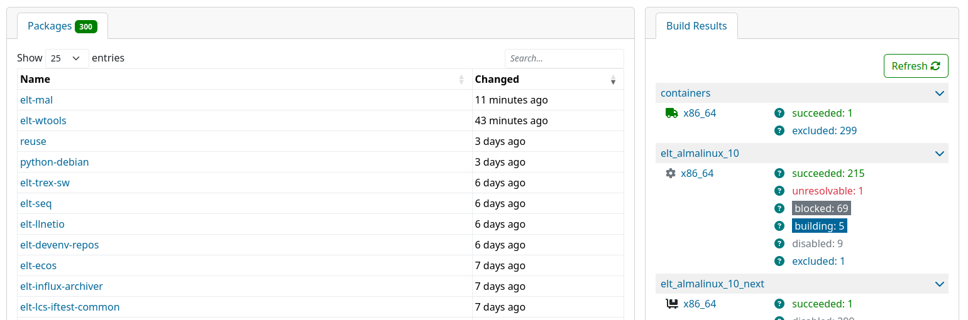
Building ELT Development Environment
  Tools for building our distribution are evolving
    fpm and alien -> SPEC + rpmbuild -> SPEC + mock -> OBS -> ??
    All software build in isolation from source
  Open Build Service from SUSE is our "Wunderwaffe"
    OBS understands the dependency tree and triggers rebuilds automatically
    Web UI - "Citizen packaging" via Request workflow
    Possible to build against multiple distributions
    Integration via hooks and REST API

Slide 14
ESO Open Source Contributions
  Software:
    Astronomical/scientific software under GPL: ACS, ESO-MIDAS, CPL, IAS
    Most of ELT software is / will be mostly LGPLv3 licensed
  Fedora / EL / EPEL:
    A few of us are Fedora/EPEL package maintainers
    We try to contribute back also to CentOS Stream / AlmaLinux
  Many contributions upstream to used projects:
    waf build system, buildroot, Nix, NixOS, Jenkins, kernel ...

Slide 15
ESO Open data and videos
  Science archive data:
    All data is available to everyone after a period of exclusive usage by the PI (usually ~1 year)
    https://archive.eso.org/cms.html
  Images and videos (including UltraHD, fulldome and VR 16k) released under CC 4.0
    https://www.eso.org/public/images/
    https://www.eso.org/public/videos/

Slide 16
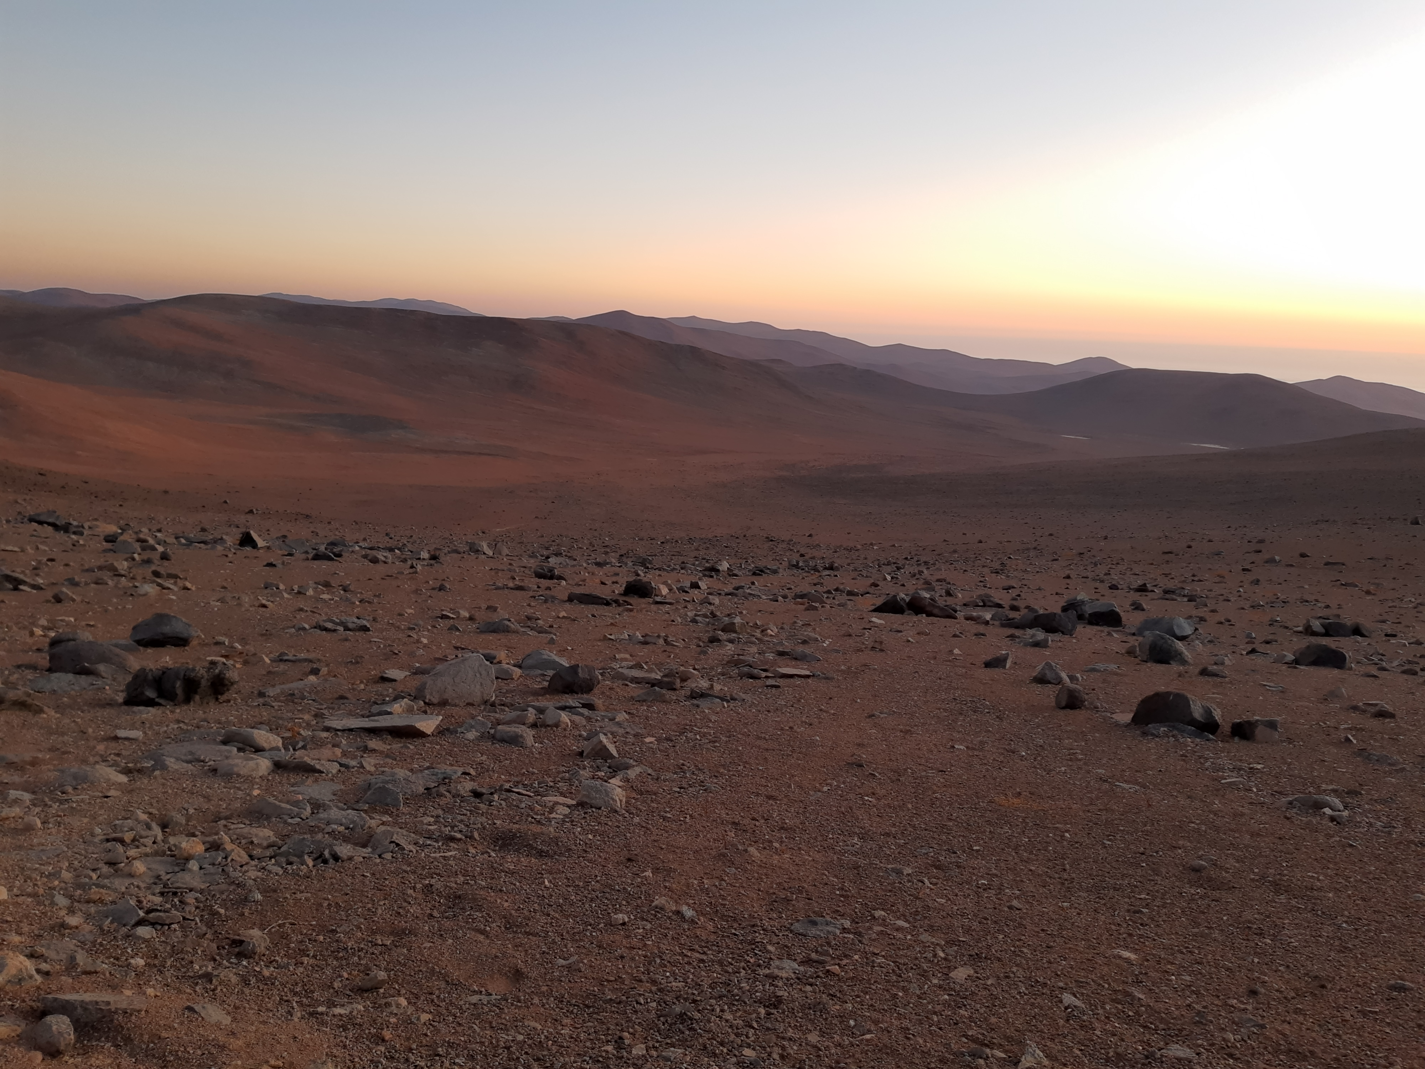
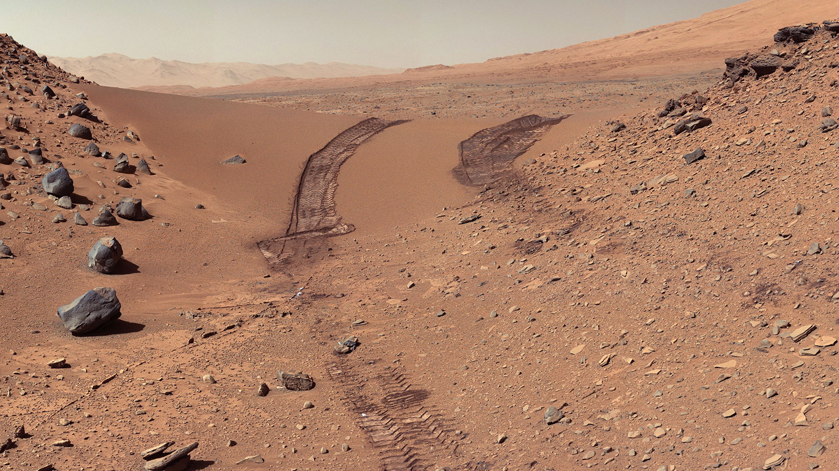
FAQ
So when are you going to Mars?

Slide 17
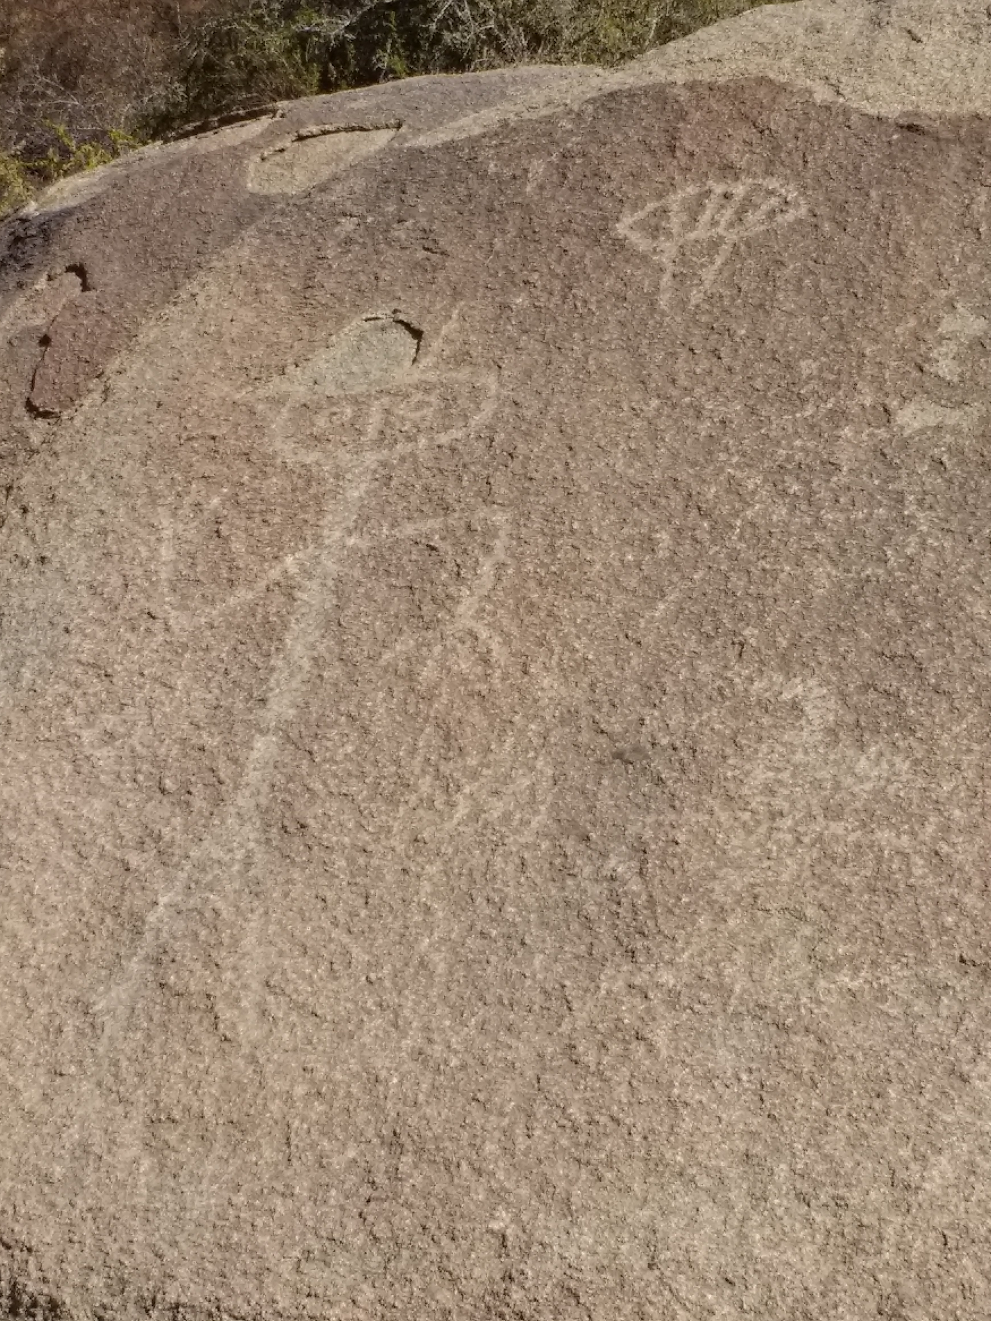
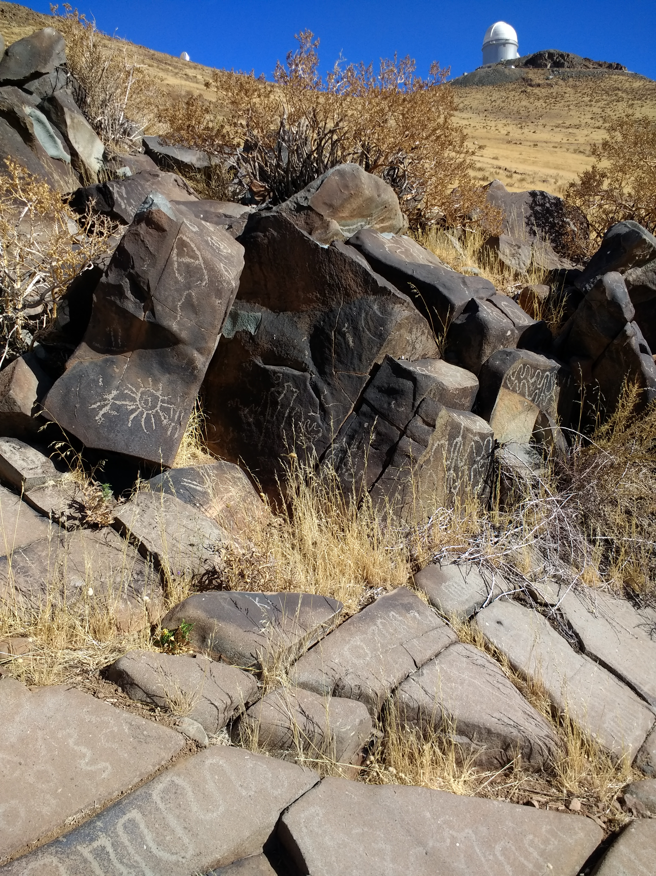
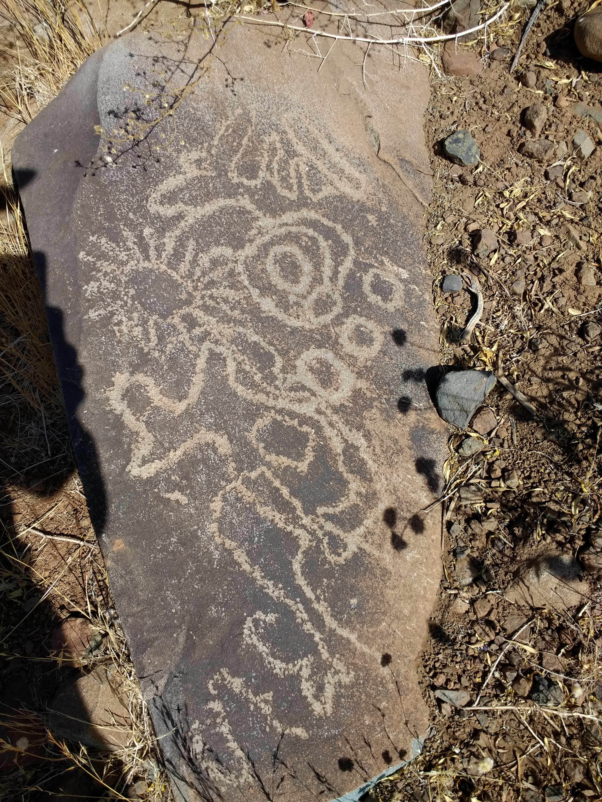
FAQ
Is there life out there?

Slide 18
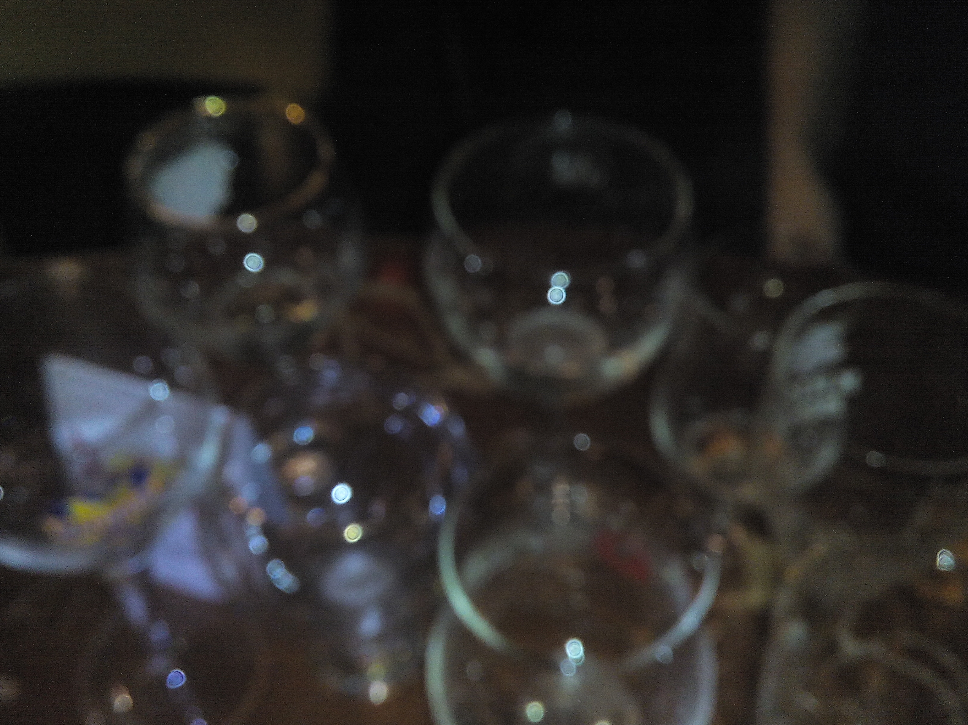
FAQ
How does my Moon sign influence my emotions?
How do transits affect my career path?
What does a Saturn return signify for me?

Slide 19
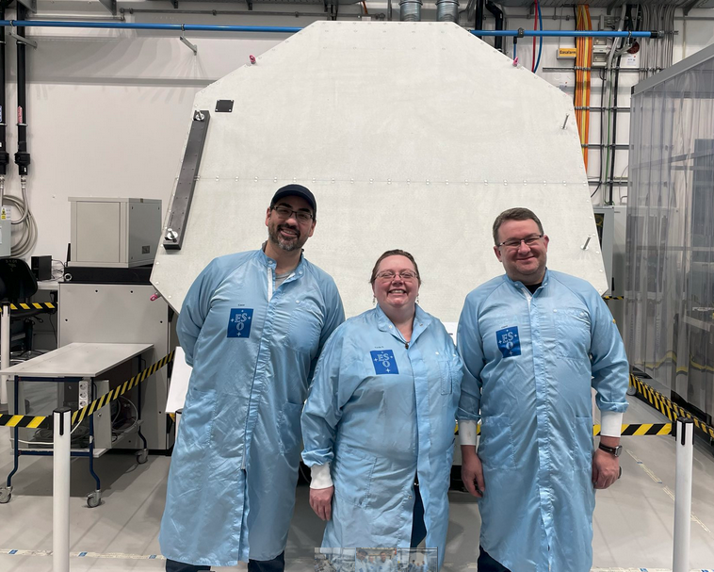
Come and visit us!
Our observatories can be visited (guided visits on Saturdays) so come by if you are in Chile!
Or you can visit our HQ and the nearby planetarium (Garching near Munich).
Thank you AlmaLinux and
Open Source
Community!!

